Slide 1

Postman
Microsoft Dynamics 365 - Finance & Operations, Budgetary Price Estimate
1

Slide 2





Quisitive at a Glance
A Premier Global Microsoft Partner
Pakistan
Canada
Toronto
UK
Hyderabad
India
1000+
Customers annually
17
resource hubs
≈800
team members
Covers the entire
Microsoft Cloud
Ottawa
Chicago
Denver
Washington DC
Los Altos
Dallas Headquarters
Los Angeles
Houston
Phoenix
Tampa
Austin
San Antonio
Montevideo
Uruguay
Regional Hubs
Global HQ
Country HQ
Regional Office
2
TSXV: QUIS | OTCQX: QUISF

Slide 3






Why Quisitive?
Full-Service Partner
Consulting, implementation, licensing, ongoing support
Microsoft Cloud Experts
Industry Expertise & Solutions
M365, Azure, D365
to solve industry challenges
Global Workforce
for flexible delivery
World-class NPS score of 85
Business Outcome Focused
Consistent, quality delivery
3

Slide 4

Why Microsoft Partnership Matters
*m
Recent Accolades
Proven Expertise
Advanced Specialization partners are rigorously reviewed and require training, certifications and demonstrated customer success. Quisitive is also certified as a FastTrack partner for M365
2022 Microsoft Inner Circle for Business Applications
2022 Microsoft US Health & Life Sciences Partner of the Year
2022 Microsoft Healthcare Partner of the Year Finalist
2021 Microsoft Healthcare Partner of the Year Winner
2020 Microsoft Azure — DevOps Partner of the Year Winner
2020 Microsoft Data Analytics Partner of the Year Finalist
2019 Microsoft United States Partner of the Year Winner
2018 Microsoft United States Partner of the Year Finalist
Quisitive is in the
TOP .01% of all Microsoft Partners
Early & Special Access
As a top Microsoft partner, Quisitive receives early preview of new technology, as well as special access to Microsoft’s technical resources for support and training.
12 Advanced Specializations
16 Gold Competencies
Access to Funding Programs
Quisitive has access to special funding mechanisms through Microsoft and can help you acquire funding to help more quickly adopt necessary solutions
4
Notes:
Additional Stats we can consider: Microsoft is now the most popular cloud services supplier and is steadily gaining market share against major competitors
-Forbes, 2020
In three years, more executives expect their companies to be using Azure than any other cloud service
-Forbes, 2020
More than 85 percent of Fortune 100 companies are using Azure
-Microsoft, 2020
Microsoft’s cloud business is larger than all but about 50 of the world’s biggest corporations.
-Cloud Wars

Slide 5
















































Innovation Across Industries
Software & High Tech
Health & Life Sciences
Public Sector
Retail
Manufacturing
Energy
Financial Services
Education
5

Slide 6

Our Understanding
6

Slide 7

Executive Summary
This Statement of Work by Quisitive outlines the integration of Microsoft Dynamics 365 for Postman, a leading API development platform. The project aims to optimize Postman's business processes including Concept to Market, Prospect to Quote, Record to Report, and Administer to Operate. Through the adoption of Dynamics 365, Postman seeks to enhance project management, CRM, human resources management, and project planning, ultimately driving efficiency and growth.
7

Slide 8
Introduction
Postman, a collaboration platform headquartered in San Francisco, is renowned for streamlining API development for over 17 million developers globally. With a commitment to fostering innovation and efficiency, Postman is poised to integrate Microsoft Dynamics 365 solutions, enhancing its business operations and supporting its mission to deliver superior API tools. This document outlines the objectives, scope, and methodology for the successful integration and optimization of essential business processes and modules.
8

Slide 9
Business Needs and Drivers
Operational Inefficiencies: Streamline workflows for improved productivity.
Limited Visibility: Enhance reporting and analytics for better insights.
Scalability Challenges: Implement scalable solutions to support growth.
Customer Relationship Management: Optimize CRM to improve client engagement and satisfaction.
9

Slide 10
General Project Scope
Solution Component | Description | Key Scope Assumption
Languages | English | Single Language for Implementation
Sites/Locations | Online | Quisitive Team will be doing implementation remotely.
Project Operations Instances | Gold, Dev, Test, Production | All of instances will be procured through Quisitive CSP offering
10

Slide 11
Process In Scope
Process | Process Description
Concept to Market | Involves creating new products and bringing them to market.
Prospect to Quote | Manages the process of handling leads and turning them into quotes.
Record to Report | Focuses on financial reporting, tracking transactions, and providing insights for decision-making.
Administer to Operate | Manages the day-to-day administrative tasks and ensures smooth operations.
11

Slide 12
Application Modules
Category | Training Description
Project management | Oversees project financials and resources.
CRM | Manage customers and relationships.
Human Resources Management | Track employees and expenses.
Project management | Plan and track projects.
12

Slide 13
Training In Scope
Category | Training Description
Methodology Training | Training on Methodology and Project Management concepts.
Solution Overview Training | Core Team Module Training prior to end-to-end testing.
User Acceptance Test training | Project team training prior to End-to-end testing includes all modules in scope.
13

Slide 14
Out of Scope
Area | Description
Microsoft Product Licenses | Microsoft product licenses and/or software subscriptions will not be provided under this SOW. The customer is responsible for acquiring all necessary product licenses. ( Covered through Quisitive CSP)
Legacy Systems | Quisitive will not be responsible for supporting Customer legacy systems.
Integration with 3rd Party Software | Quisitive will not be responsible for integration with 3rd Party Software (not applicable to Dynamics ISVs) which are not part of the scope.
Requirements Gathering | Quisitive will analyze the requirements documented for processes identified as in scope. Any business process outside of the scope will not be analyzed as part of this proposal.
Documentation | Preparation of documentation about any existing process, previous standards, policies or existing guidelines is out of scope under this proposal.
Process Re-engineering/Process Mapping | Design of functional business components of the solution unless specifically included in the scope and delivered by Quisitive Consulting staff.
Adoption & Change Management | Design or re-design of Customer's functional organization unless specifically included in the scope and delivered by Quisitive Consulting staff.
Global Solution Needs | Language implementations that are not part of the core product will not be implemented under this SOW.
Business Intelligence and Data Warehousing | Unless specifically detailed in this document, implementation and/or data replication to support business intelligence and data warehousing are not included in this proposal.
14

Slide 15
Implementation Approach
15

Slide 16
Implementation Methodology
What is Microsoft Dynamics Sure Step?
A proven methodology with Integrated tools and project management for smooth Implementation. Sure Step helps us deliver a predictable, on-time and on-budget Microsoft Dynamics 365 implementation that can provide you a quick return on investment and meet your business requirements.
16

Slide 17
Implementation Methodology
Implementation Approach
Build
Implement
Replicate
Identify Business Needs
Define Solution Blueprint
Build Global template
Develop & Test Solution
Data Migration Scripts
Develop Integration
Train the Trainers
End User Training
Data Migration for uptake
Go-Live
Operations Support
Train Customer Implementation team
Implementation Support for other countries
Create L1 Support team within Customer
17

Slide 18
Quisitive & Microsoft – Integrated Delivery Framework
Microsoft Customer Success
Measures
Customer Solution Health
Adoption Advocacy Business Value
Quisitive Implementation Team
Project Envisioning
Project Initiation
Project Delivery
Project Support
Non-Iterative
Iterative
Non-Iterative
Discovery
Mobilization
Initiation
Analysis
Build
Solution Testing
Deployment
Production Support
Operations
Design
Develop
Iterative testing
Process
End-to-End
Performance
UAT
Training
Data Migration
Testing / Quality Assurance
Project Governance & Change Management
REGULAR TOUCHPOINTS
Microsoft Fast Track
W1.1
W1.2
W2.2
W2.1
W3.1
W3.2
W4.1
W5.1
18
Pre-Kickoff (Partner Only)
Kickoff
Solution Milestone Workshop
Governance Milestone Workshop
Build Milestone Workshop
Build Iterations (CRP)
Pre Go-Live Milestone Workshop
Post Go-Live Review

Slide 19
Implementation Methodology
Project team Organization
Steering Committee
Customer
Microsoft
Quisitive
Executive Sponsor
Executive Sponsor
Executive Sponsor
Project Team Organization
Project Business Sponsor
Project IT Sponsor
Fastrack Architect
Customer Success Manager
Engagement Manager
Industry – Center of Excellence
Program Manager
Program Manager
Project Manager
Change Management Lead
Project Manager
Work Stream Lead (Finance )
Work Stream Lead (Project Governance)
Work Stream Lead (Project Delivery)
Training Lead
Delivery Architect
Technical Lead
Technical Architect
Functional Consultant (Finance)
Integration Architect
Subject Matter Expert (SME)
Subject Matter Expert (SME)
Subject Matter Expert (SME)
Functional Consultant (Project Governance)
Data Migration Architect
Subject Matter Expert (SME)
Subject Matter Expert (SME)
Subject Matter Expert (SME)
Functional Consultant (Project Delivery)
Dev Lead
Developers
19

Slide 20
Project Team Organization
Customer Team
Quisitive Team
Executive Sponsor
10%
Executive Sponsor
10%
Project Business Sponsor
10%
Engagement Manager
10%
Project IT Sponsor
10%
Program Manager - PMO
10%
Core Team
Program Manager
10%
Project Manager
50%
Project Manager
100%
Delivery Architect (FS, CS)
50%
Work Stream Leads (WSL)
100%
Functional Consultants
100%
Subject Matter Experts
35%
Technical Consultants
100%
Integration Architect
50%
Integration Architect
50%
Data Migration Architect
50%
Data Migration Architect
50%
Developers
OD
Developers
OD
20

Slide 21


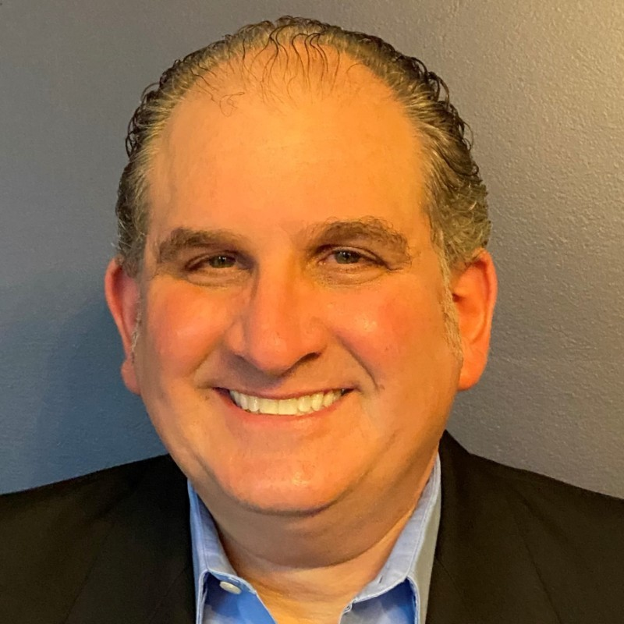
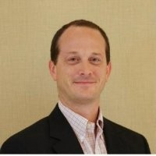
Quisitive Project Leadership Team
Lane Sorgen
SVP – Global Business Application
Executive Sponsor
Ex Microsoft with over 25 years of high-scale project leadership experience. Focuses on project business drivers and ensures strategic alignment
Syed Fahad
VP – Global Industry Solution
Industry – Center of Excellence
Ex Microsoft with over 20 years of industry solutions. Focuses on Industry compliance and ensures the solution delivery is aligned with the industry requirement
Spencer Stern
Sr. Director – Global Business Application
Engagement Manager
Ex Microsoft with over 20 years of public sector program delivery experience. Focuses on project business drivers and ensures strategic alignment
Peter Lane
VP – Client Success
Account Executive
TBD
21

Slide 22



Quisitive Project Delivery Team
Paul Limke
Sr. Project Manager
Project Manager
TBD
Kaushik Ramakrishnan
Practice Lead
Solution Architect
TBD
TBD
TBD
Delivery Architect
TBD
TBD
TBD
Technical Architect
TBD
22

Slide 23
Proposal
Timeline & Cost Estimates
23

Slide 24
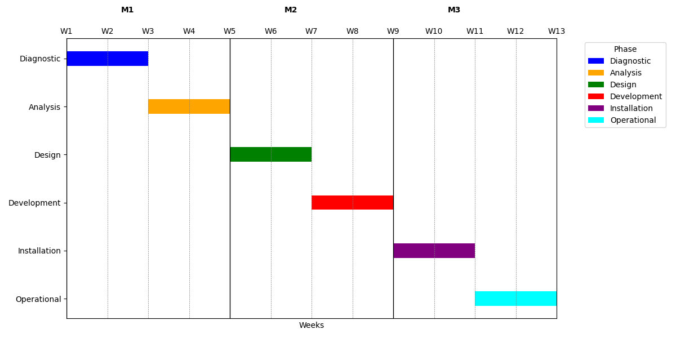
Project Timeline
24

Slide 25
Questions
25

